Slide 1
How to Use Critical Path Method for Complete Beginners (with Examples)

Slide 2
Introduction
This technique involved mapping out the most important tasks in any project and using that information to estimate the project's completion date.
The Critical Path Method in project management is a cornerstone of project planning even to this day. How long a project takes often depends on the most important tasks that constitute it.
If you can map out these tasks and their duration, you can get a reasonable estimate of the project’s timeline and budget.

Slide 3
Understand the Critical Path Method
Have you ever heard of the Theory of Constraints (TOC)?
First described by Eliyahu Goldratt in his 1984 book, The Goal, this theory states that your ability to complete any activity hinges on a few critical resources or constraints.
For example, if you’re making a sandwich, you might have all the butter, ham, and cheese you need, but if you don’t have bread, you can’t make a sandwich.
In this case, the bread would be the constraint on which your sandwich-making project depends.
The Critical Path Method is similar to this theory but broader in focus. According to this method, the success of any project depends on the timely completion of tasks along a critical path.

Slide 4
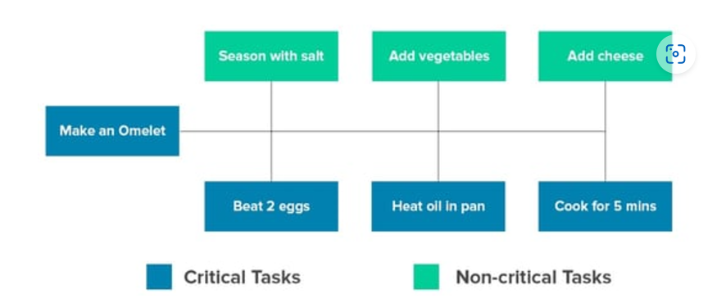
What is the Critical Path Method, and what is a Critical Task?
Every project, regardless of size or budget, has some core tasks crucial to completion. A task is defined as critical if it is delayed, slowing down the completion of the entire project
The sequence of these steps describes the critical path a new cook must take to make an omelet.

Slide 5
Critical Path Method Definition
The Critical Path Method is defined in the Project Management Body of Knowledge (PMBOK) as follows:
“The Critical Path Method is the sequence of scheduled activities that determines the project's duration.”
These scheduled activities must be performed if the project is to be considered a success. Moreover, they must be completed in a specific order. If you’re building a house, you can’t construct the walls and then dig the foundation; you must do it sequentially.

Slide 6
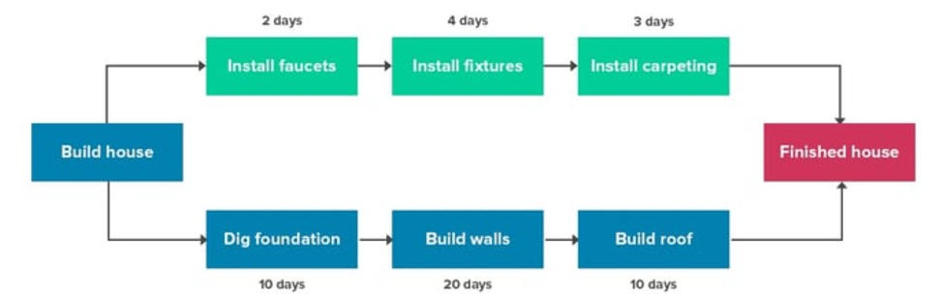
The important bit to understand is that the CPM describes the longest sequence of tasks in the project.
In any project, there will be multiple task sequences. The CPM would describe the sequence that takes the most time.
For example, if you’re building a house, you would have several task sequences as follows:
Each task requires different amounts of time and resources. For example, it takes more time to build walls and lay the roof than to install faucets and fixtures.

Slide 7
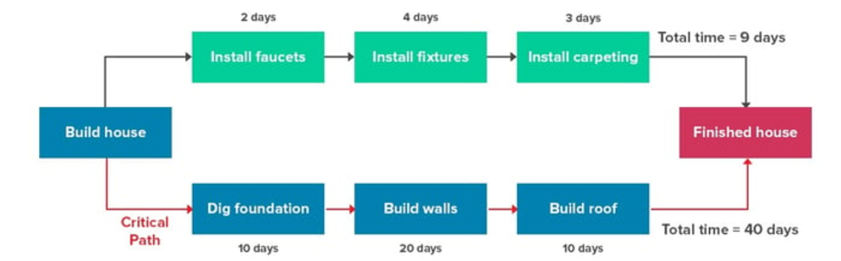
If you had to figure out the project’s ‘Critical Path’, you would look at the sequence that takes the most amount of time, like this:
The total time to complete the sequence along this critical path would give you an idea of the project’s minimum duration.
You might undertake several task sequences simultaneously, but if the critical path sequence is delayed, your project will also suffer.

Slide 8
The Critical Path Algorithm Explained
The Critical Path Method is essentially an algorithm for decision-making. This algorithm takes a task's start, duration, and finish time to determine which activities deserve the most attention (i.e., are "critical" for the project)

Slide 9
Cont..
There are two methods by which we can identify the critical path.
The first method is to list down all the paths or options that are available to go from the start node to the end node. Once these paths are listed down, we compute the time it takes from the start node to the end node in traversing these paths. The path with the maximum duration or the longest duration is the critical path.
The first method does not help us in performing the analysis of ‘surpluses’ which is also called the ‘float’ analysis. Float is the surplus available in terms of duration on some of the activities. Activities with positive float can be delayed upto that extent and this delay would not affect the project duration. Any delay in activities greater than the float would delay the entire project. Some activities in the network are characterized by ‘zero’ float and these activities are critical path activities. As the floats are ‘0’, none of the critical path activities can ever be delayed or else the project would be delayed.

Slide 10
Cont..
To calculate the float for all activities, we need to compute the
earliest start (ES),
earliest finish (EF),
latest finish (LF) and
latest start (LS) that every activity can have.
Furthermore, this information can be shown on the network itself or in a table form.
Earliest Finish (EF) = Earliest Start (ES) + Activity Duration
Latest Start (LS) = Latest Finish (LF) - Activity Duration
Computation of earliest start and earliest finish is called ‘forward pass’ as we start from the first node and proceed towards the last node. In case of forward pass, the information on ES is known and EF has to be calculated.

Slide 11
Cont..
Computation of the latest finish and latest start is called the ‘backward pass’ as in this case, we start with the last activity finish times and work backwards towards the first activity latest start times. In case of backward pass, the information on LF is known and LS has to be calculated.
For critical path activities, the earliest start and latest start (or earliest finish and latest finish) times are the same.
For activities on non-critical paths, there is a positive difference between latest start and earliest start (and the value remains the same if we calculate the difference between latest finish and earliest finish). This positive difference, known as the ‘FLOAT’ for an activity, indicates the delay that can be tolerated on these activities without delaying the project. As a corollary, since this difference is zero for critical path activities, there is no surplus or FLOAT available on critical path.

Slide 12
Cont..
The surplus available at the nodes or events is known as ‘SLACK’ for the event. If more than one activity has the same tail event, then the smallest of the activity floats becomes the tail slack. If only one activity starts from the tail event, then the activity Float becomes the tail event Slack.
We will use the square brackets to describe the ES, EF values, [ES, EF] and curved brackets for describing the LS, LF values {LS, LF}.
Free float= ES (of successor)-EF (current) (The amount of time an activity can be delayed without affecting other tasks or the completion of the project)
The difference between the latest start time and early start time for every activity is the delay permissible in starting the respective activity or the surplus available for that activity or total float (LS-ES)/Float= LF-EF for that activity.
A positive float value indicates that an activity can be delayed without delaying the project's completion. A negative float value indicates potential project delays.

Slide 13
